Slide 1
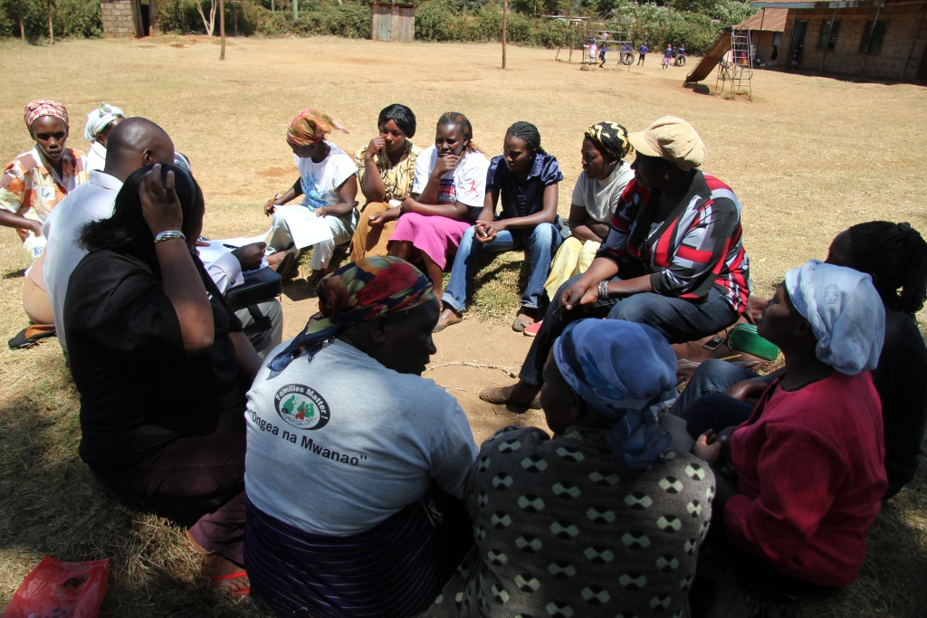
CHAMA SPHERE
Group 9 members
Juma Sharon D33/3460/2020
James Karanja D33/2798/2020
Mourene Abel D33/3421/2020
Elias Murangiri D33/3239/2020
Lavenda Awuor D33/3406/2020
Ernest Wechuli D33/3068/2017
Sharon Otieno D33/3427/2020

Slide 2
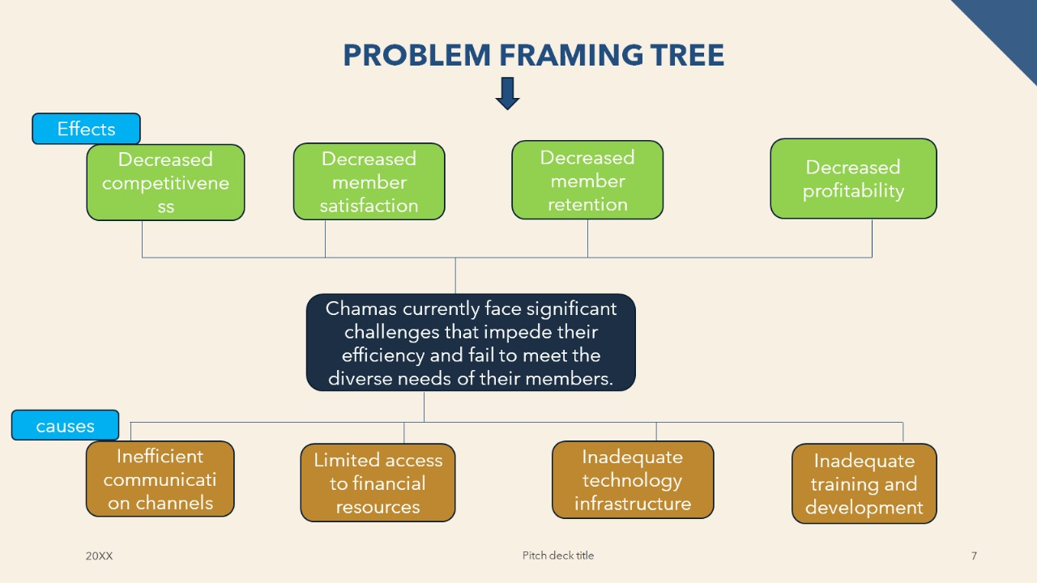
PROBLEM STATEMENT
Chamas,a segment in the Financial sector is facing challenges due to regulatory hurdles and limited access to capital.Additionally,there are unmet customer needs such as lack of digital solutions and limited financial literacy.

Slide 3

IDEATION ANALYSIS MATRIX
c
Criteria | Digital Chama Platform | Mobile App For Transactions | Block chain-based Ledger
Feasibility | High | Moderate | Moderate
Impact on transparency | High | Moderate | High
Accessibility | High | High | Moderate
Collaboration features | High | Moderate | Low
User adoption | Moderate | High | Moderate
Initial development cost | Moderate | High | High
Security | Moderate | High | High

Slide 4





BUSINESS CANVAS
KEY
PATNERS
Financial institutions (Banks, Microfinance).
Technology providers for digital platforms.
Regulatory bodies for compliance.
KEY ACTIVITIES
Organizing and managing Chama groups.
Partnerships with financial institutions and tech providers.
Ensuring regulatory compliance.
Financial education for members.
VALUE PROPOSITION
Affordable financial solutions through collective action.
Loans, savings, and investment opportunities for members.
CUSTOMER RELATIONSHIPS
Community-building for trust and support.
Effective communication within groups.
Conflict resolution mechanisms.
CUSTOMER SEGMENTS
Micro, Small, and Medium Enterprises (SMEs).
Individuals seeking accessible finance options.
KEY RESOURCES
Skilled personnel for group facilitation.
Robust technology infrastructure for digital tools.
Financial and legal expertise compliance.
Educational resources for member training.
CHANNELS
Online platforms and mobile apps.
Physical meeting locations for member engagement.
COST STRUCTURE
Operational costs.
Technology development and maintenance.
Marketing and promotional expenses.
Regulatory compliance costs.
REVENUESTREAMS
Membership fees and contributions.
Fees for financial services.
Digital platform access fees.
Grants and funding.

Slide 5









PROTOTYPE SCHEMA
ChamaSphere
Available Services
Financial Literacy
Welcome to chamasphere. Get insightful financial information while accessing your transaction history all in a click.
View all services
Resources; 1.Rich Dad Poor Dad.
2.The Intelligent Investor.
3.The Millionaire Next Door.
Quote of the day “A part of all you earn is yours to keep.” - George S. Clason.

Slide 6

PITCH DECK Team 9

Slide 7

ABOUT US
At Chamasphere,we empower chamas to foster collaborative thinking to further drive innovation .By closing the loop on financial management and using the latest technology, we help chamas grow and nature a portfolio diversification mindset.

Slide 8

PROBLEM
MARKET GAP
Chama's need financial management tools but are using outdated products
USABILITY
Customers want something that is simple to use and to adapt.
FINANCIALS
Adoption of financial management software was up by over 60% in 2023
CUSTOMERS
10% increase of financial management tools proves that theres customers interested for more simple management tools and technology
COSTS
Loss of sales by not offering easier management tools that push chama’s to the finish line.
8

Slide 9


“All~ in ~one Chama solution”
CLOSE THE GAP
Chamasphere makes task management easier and no other product in the market offers the same
EASY COMMUNICATION
We offer a seamless communication tool with a transparent reporting for all members.
EASY TO USE
A simple product that gives Chamas tools and a platform to meet their investment goals
COST SAVING
Reduce costs for client by helping Chama members stay on target within deadlines.
9

Slide 10





PRODUCT OVERVIEW
UNIQUE
Only product specifically dedicated to financial management
FIRST TO MARKET
First beautifully designed product that’s both stylish and functional
AUTHENTIC
Designed with the help and input of software experts
TESTED
Conducted testing with startup areas
PRODUCT BENEFIT
Simple and efficient to use​
Quick customer service assistance​(inbuilt AI chatbot)
Free 90-day trial for new customers​​
10

Slide 11
Our business Model
Research​
We based our research on market trends and software sales ​
Our target audience
Chama members.
Financial advisors and individual investors
Financial institutions
Abstract​
We believe people need new management tools to help businesses achieve their OKRs​
Design​
Minimalist design and easy to use ​

Slide 12

MAJOR COMPETITORS
Chamasphere
Our competitors
Chamasphere is priced below that of other financial management tools on the market​
Simple and easy to use app and website, compared to the complex tools of our competitors​
Affordability is the main draw for our consumers to our product​
Company A​lpha Product is more expensive​
Companies G&Z ​ Product is expensive and inconvenient to use​
Companies DY’ & Beta Product is affordable, but inconvenient to use

Slide 13

COMPETITION
Convenient
ChamaSphere
Alpha
Expensive​
Affordable
G
DY’
Beta
Z
Inconvenient​
13

Slide 14
Our growth strategy
How we’ll scale in the future​
Feb 2024
May 2024
Oct 2024
Distribute the app to local start ups to help establish the product
Release the app to the general public and monitor press and regional market trends
Gather feedback from the start up community to expand availability of the product

Slide 15
TRACTION
Forecasting for success​
Revenue by year
Key Metrics
 | clients | orders | Gross revenue | Net revenue
2024​ | 10​ | 1100​ | $10,000​ | $7,000​
2025 | 20​ | 200​ | $20,000​ | $16,000​
2026​ | 30​ | 300​ | $30,000​ | $25,000​
2027 | 40​ | 400​ | $40,000​ | $30,000

Slide 16
REQUIRED FUNDING
$12K
$14K
$32K
$82K
CAMPAIGNS
ANGEL INVESTMENTS
CASH
SHARES
Revenue obtained from online campaigns and reorders
Amount obtained through other investors​
Liquid cash we have
on hand​
Number of shares converted into USD​

Slide 17

RESOURCE ALLOCATION
DEVELOPMENT
$30,000
CUSTOMER SERVICE & CONTINGENCY
$9,000
MARKETING
$15,000
RESEARCH
$10,000

Slide 18
Two-year action plan
Run focus groups​
Gather feedback​
Supply volunteers​
2024
Jan
Feb
Mar
Apr
May
Jun
Jul
Aug
Sep
Oct
Nov
Dec
Test with start ups​
Regional launch​
Deliver to consumers​
2025
Jan
Feb
Mar
Apr
May
Jun
Jul
Aug
Sep
Oct
Nov
Dec

Slide 19

At ChamaSphere, we believe in giving 110%. By closing the loop on financial management and using the latest technology, we help businesses grow and nurture a consumer-first mindset. We thrive because of our market knowledge and a great team behind our product. As our CEO says, "Efficiencies will come from proactively transforming how we do business."
ANY QUESTIONS ?

Slide 20




THANK YOU!
Morene Abel
chamasphere@gmail.com
678-555-0100

